Slide 1

Employee Attrition Analysis for Frito Lay
MSDS 6306 – Doing Data Science
Nashita Khandaker

Slide 2
Table of Contents
01
02
03
04
05
06
Executive Summary
The Data
Key Findings
Model Evaluation
Best Model
Business Impact

Slide 3
01
Executive Summary

Slide 4
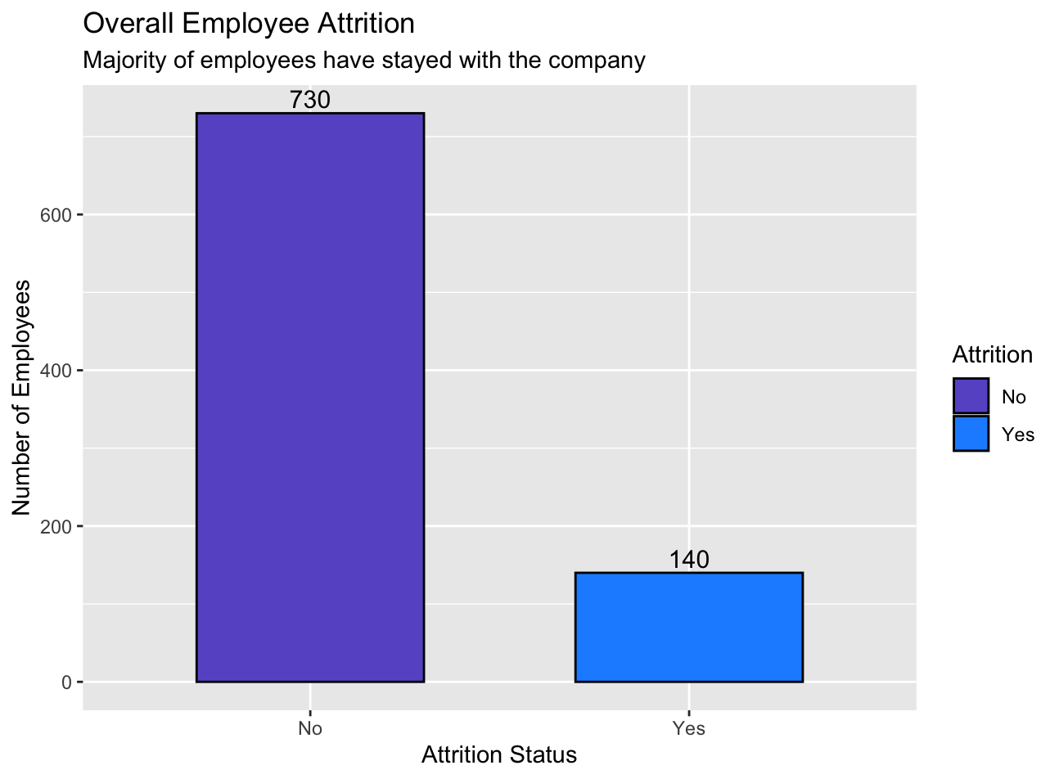
Objectives
Problem:
Employee attrition is costly — replacing a single employee can cost 50–400% of their annual salary. Frito Lay seeks to understand what drives turnover and how to proactively retain valuable talent.
Solution:
Develop a predictive model to identify employees at high risk of leaving, supported by data-driven insights on the most influential factors.

Slide 5
02
Exploratory Data Analysis

Slide 6
Understanding Patterns
Goal
Approach
Key Observations
Explore which employee characteristics correlate most with attrition before building predictive models.
Tested multiple variables.
Compared against Attrition using visual patterns.
Selected features that showed clear separation or business relevance.
Some fields showed strong relationships with attrition.
These became focus variables for modeling.

Slide 7
03
Key Findings

Slide 8
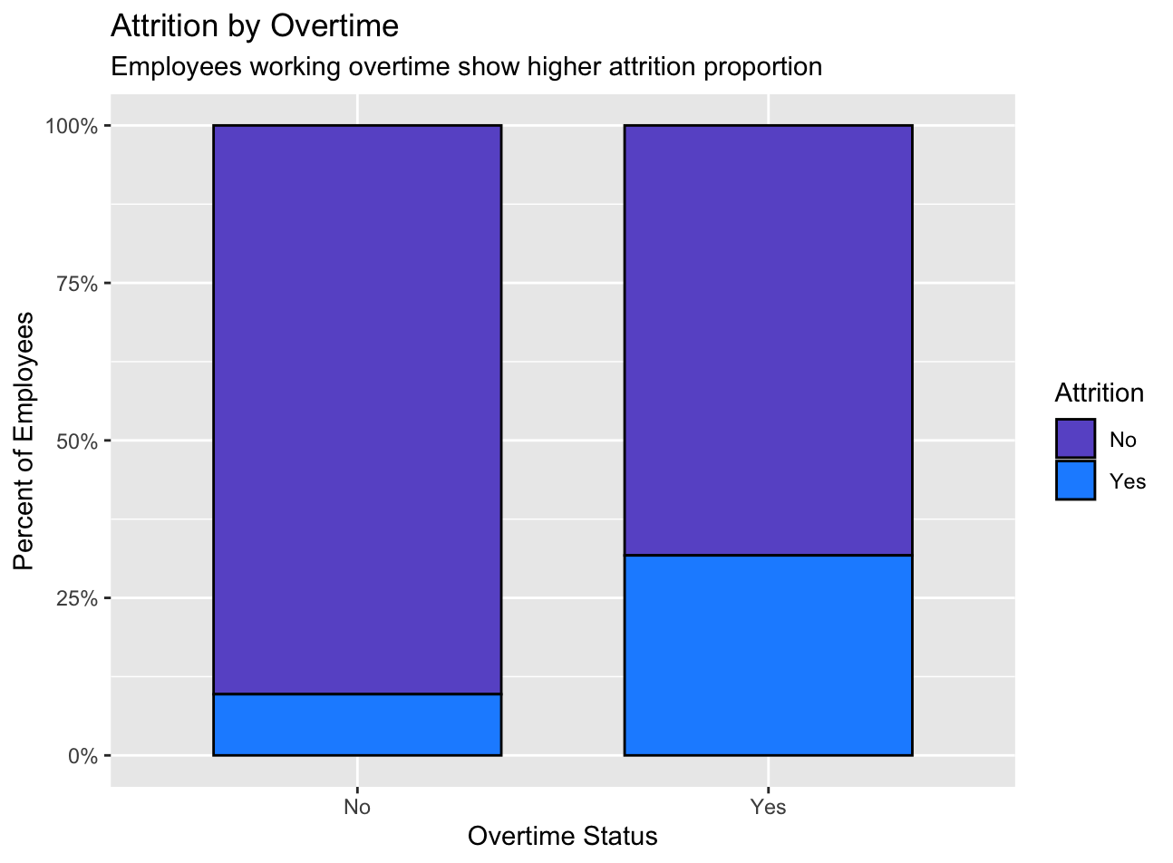
Working Overtime
Workload and burnout; need balanced scheduling and workload management programs.

Slide 9
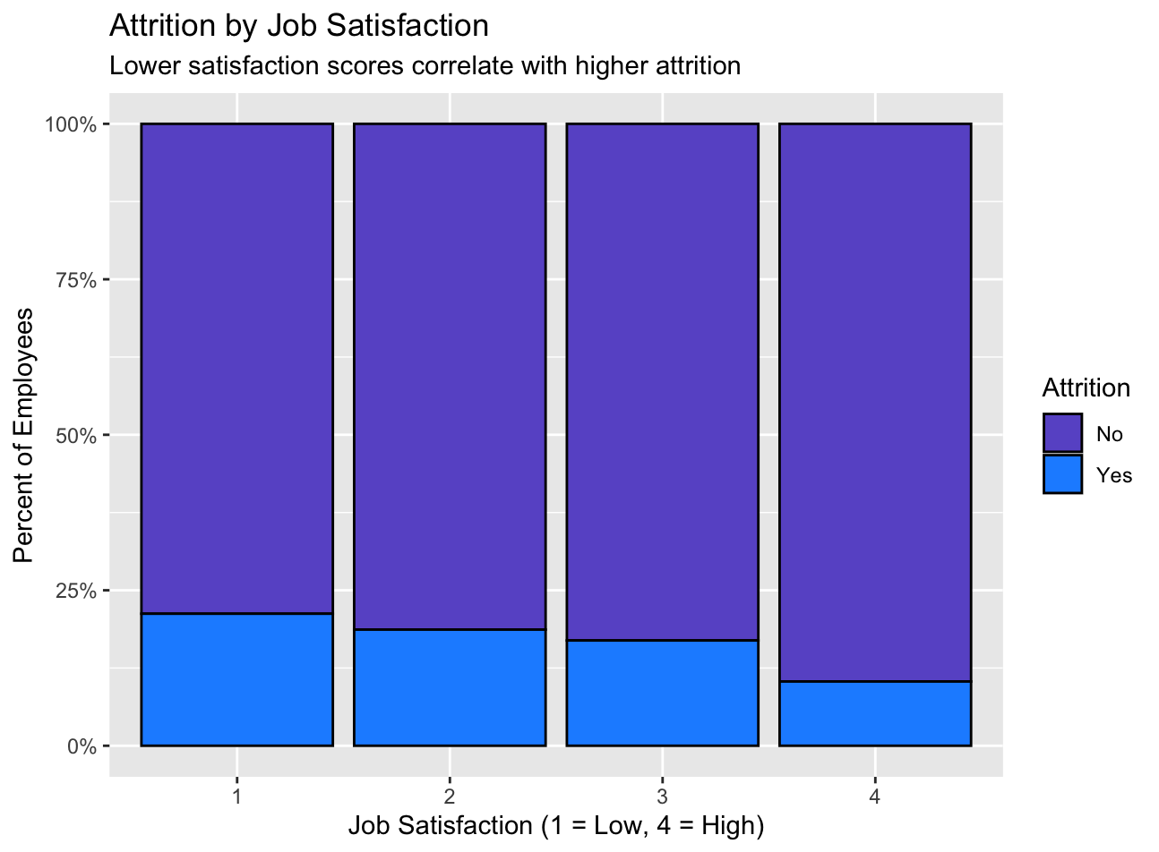
Job Satisfaction
Lower satisfaction → higher turnover. Focus on recognition and development to retain talent.

Slide 10
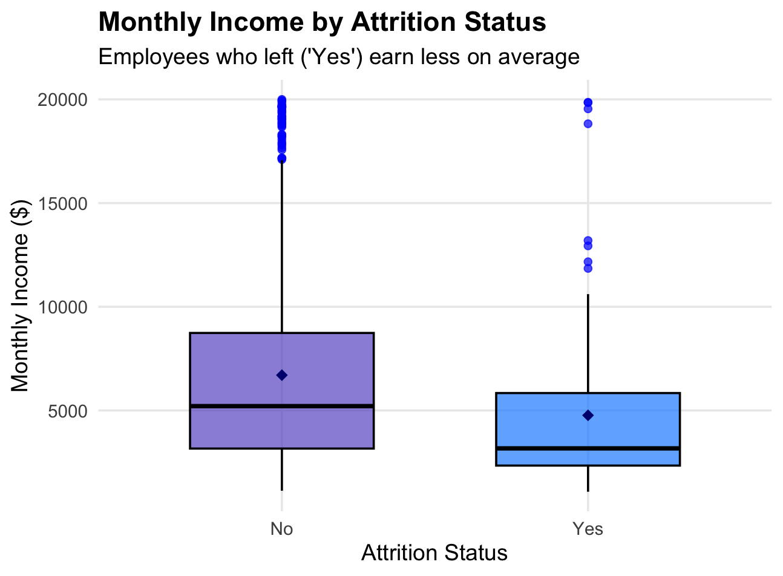
Monthly Income
Lower-paid employees are more likely to leave — competitive pay and growth paths can improve retention.

Slide 11
04
Model Evaluation

Slide 12
Model Development Process
1
2
3
4
Data Preparation
Model Training
Evaluation
Best Model Selection
Cleaning dataset
K-Nearest Neighbor vs. Naive Bayes
Several metrics for analysis
NB based on performance summary

Slide 13
Performance Summary
Metric | KNN | Naive Bayes
Accuracy | 63.8% | 74.7%
Sensitivity | 70.97% | 64.52%
Specificity | 62.24% | 76.92%
Precision | 28.95% | 37.74%
F1 Score | 41% | 47.8%
Balanced Accuracy | 66.66% | 70.72%
Kappa Statistic | 0.2117 | 0.3243

Slide 14
05
Best Model

Slide 15
Confusion Matrix
Metric | Predicted No | Predicted Yes
Actual No | 110 | 11
Actual yes | 33 | 20
‘Positive’ Class = Yes

Slide 16
Cost Savings
Assumption | Value
Average Salary | $76,683
Replacement Cost | 100% of salary
Incentive | $200 / employee
Retention Effect | 10%
Model Sensitivity | 64.5%
Estimated Net Savings ≈ $675K / year

Slide 17
06
Business Impact

Slide 18
Insights
7 in 10 true leavers detected → enables early HR intervention
Reduced turnover risk: proactive outreach before resignation
Strategic benefit: data-driven retention and workforce planning

Slide 19



Thank you!
Presentation: https://youtu.be/FpO10GJcLcA
Git: https://github.com/nashitakhandaker/CaseStudy1.git
Email: nkhandaker@smu.edu

